Slide 1
Technology for Success: Computer Concepts

Slide 2
Digital Transformation: Cloud, E-commerce, and AI
Module 12

Slide 3
Lesson Objectives
Explain the basic concepts of cloud computing
Describe ways companies do business on the Internet
Explain the basic concepts of artificial intelligence (AI)
Use AI technologies
Analyze ways to communicate more proficiently with AI systems
Campbell/Ciampa/Clemens/Freund/Frydenberg/Hooper/Ruffolo/West, Technology for Success: Computer Concepts, 1st Edition. © 2020 Cengage. All Rights Reserved. May not be scanned, copied or duplicated, or posted to a publicly accessible website, in whole or in part.

Slide 4
Explain the Basic Concepts of Cloud Computing (1 of 2)
Identify defining characteristics of cloud computing
Compare the most common cloud computing models
List major cloud providers and services
Explain how cloud services are used in the workplace
Campbell/Ciampa/Clemens/Freund/Frydenberg/Hooper/Ruffolo/West, Technology for Success: Computer Concepts, 1st Edition. © 2020 Cengage. All Rights Reserved. May not be scanned, copied or duplicated, or posted to a publicly accessible website, in whole or in part.

Slide 5
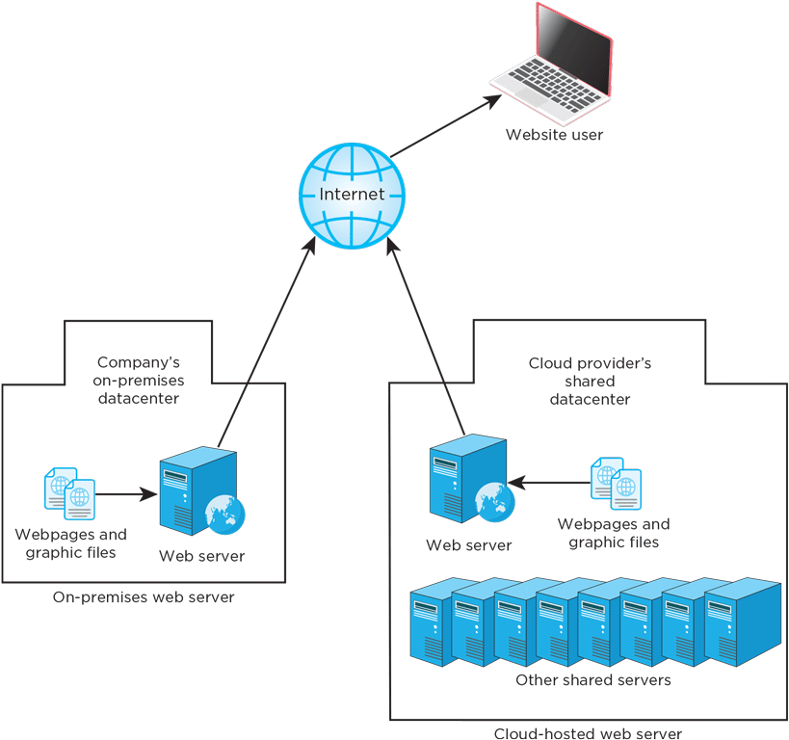
Explain the Basic Concepts of Cloud Computing (2 of 2)
Cloud computing: providing and using computer tools, such as software, via the Internet
Private cloud: does not use the Internet
Public cloud: multiple customers use the same, Internet-connected cloud
Person or business pays a fee to use someone else’s hardware
Figure 12-1: When hosting a website in the cloud, the website owner does not have to purchase or maintain their own hardware
Campbell/Ciampa/Clemens/Freund/Frydenberg/Hooper/Ruffolo/West, Technology for Success: Computer Concepts, 1st Edition. © 2020 Cengage. All Rights Reserved. May not be scanned, copied or duplicated, or posted to a publicly accessible website, in whole or in part.

Slide 6
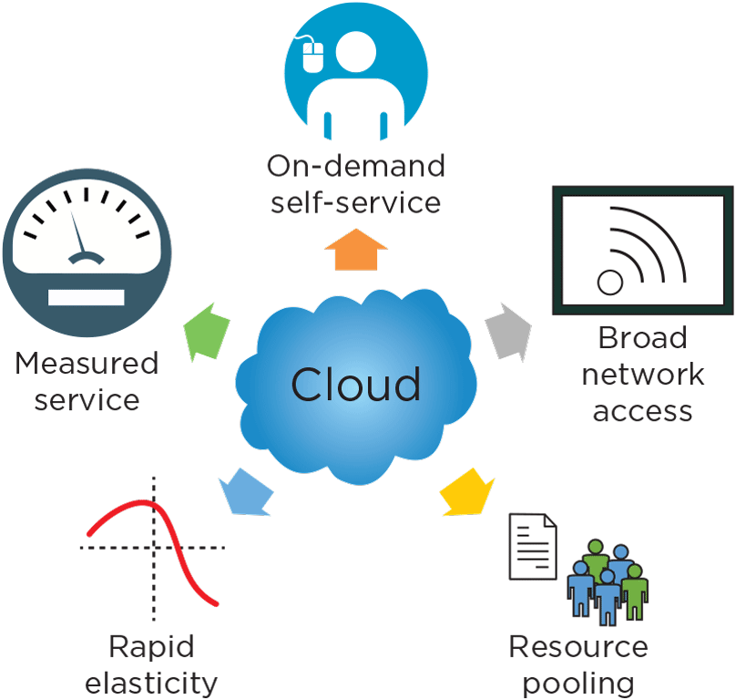
Identify Defining Characteristics of Cloud Computing
The National Institute of Standards and Technology (NIST) has defined five essential characteristics of cloud technology
Figure 12-2: Five essential characteristics of cloud technology
Campbell/Ciampa/Clemens/Freund/Frydenberg/Hooper/Ruffolo/West, Technology for Success: Computer Concepts, 1st Edition. © 2020 Cengage. All Rights Reserved. May not be scanned, copied or duplicated, or posted to a publicly accessible website, in whole or in part.

Slide 7
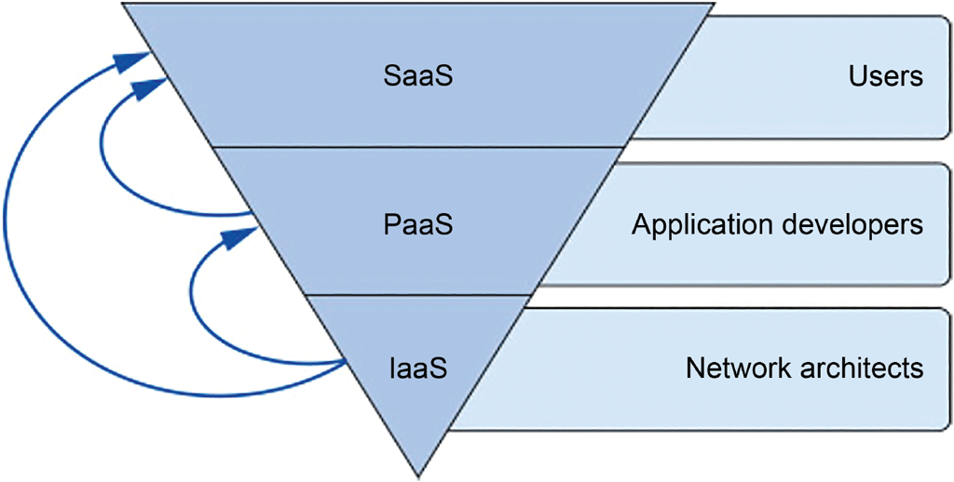
Compare the Most Common Cloud Computing Models
Cloud services can be generally categorized according to the service’s role
Figure 12-4: SaaS services are more immediately accessible to a wide market of users than other categories of cloud services
Campbell/Ciampa/Clemens/Freund/Frydenberg/Hooper/Ruffolo/West, Technology for Success: Computer Concepts, 1st Edition. © 2020 Cengage. All Rights Reserved. May not be scanned, copied or duplicated, or posted to a publicly accessible website, in whole or in part.

Slide 8
List Major Cloud Providers and Services
A handful of companies lead the cloud provider market
Amazon Web Services
Microsoft Azure
Google Cloud Platform
IBM Cloud
China’s Alibaba Cloud
Campbell/Ciampa/Clemens/Freund/Frydenberg/Hooper/Ruffolo/West, Technology for Success: Computer Concepts, 1st Edition. © 2020 Cengage. All Rights Reserved. May not be scanned, copied or duplicated, or posted to a publicly accessible website, in whole or in part.

Slide 9
Explain How Cloud Services Are Used in the Workplace
Cloud-hosted resources are used to do many tasks
Track work schedule and hours worked
Make changes to tax withholdings or benefits disbursements
Share files with colleagues
Collaborate with teammates on projects, deadlines, and events
Complete on-the-job training
Access customized workstation from any computer
Use robust applications without having to install expensive software
Work with expansive company data from across multiple departments
Keep a more flexible work schedule
Campbell/Ciampa/Clemens/Freund/Frydenberg/Hooper/Ruffolo/West, Technology for Success: Computer Concepts, 1st Edition. © 2020 Cengage. All Rights Reserved. May not be scanned, copied or duplicated, or posted to a publicly accessible website, in whole or in part.

Slide 10
Describe Ways Companies Do Business on the Internet (1 of 2)
Describe the roles of physical and virtual stores in omnichannel marketing
Compare types of e-commerce platforms
Describe high-growth jobs in the e-commerce industry
Build trust through a good e-commerce website
Campbell/Ciampa/Clemens/Freund/Frydenberg/Hooper/Ruffolo/West, Technology for Success: Computer Concepts, 1st Edition. © 2020 Cengage. All Rights Reserved. May not be scanned, copied or duplicated, or posted to a publicly accessible website, in whole or in part.

Slide 11
Describe Ways Companies Do Business on the Internet (2 of 2)
E-business: any kind of business activity conducted online
Some e-businesses use cloud-hosted resources, such as a video conferencing web app, while others rely on websites
E-commerce: process of conducting buy and sell transactions on an electronic network
Most companies these days have reached the conclusion that e-commerce is a necessary component to their overall business strategy
Campbell/Ciampa/Clemens/Freund/Frydenberg/Hooper/Ruffolo/West, Technology for Success: Computer Concepts, 1st Edition. © 2020 Cengage. All Rights Reserved. May not be scanned, copied or duplicated, or posted to a publicly accessible website, in whole or in part.

Slide 12
Describe the Roles of Physical and Virtual Stores in Omnichannel Marketing
Retailers increasingly use multiple types of contact, such as an online store and a physical store, to reach a customer
This omnichannel strategy might also include targeted ads on social media, paid results on search engines, or contacts by email or phone
Companies attempt to match the customer’s specific interests
Unique selling proposition (USP): statement about how the company and its products are different and better than the competition
Campbell/Ciampa/Clemens/Freund/Frydenberg/Hooper/Ruffolo/West, Technology for Success: Computer Concepts, 1st Edition. © 2020 Cengage. All Rights Reserved. May not be scanned, copied or duplicated, or posted to a publicly accessible website, in whole or in part.

Slide 13
Compare Types of E-commerce Platforms
Transaction types
Business-to-consumer (B2C): sale of goods and services to the general public
Consumer-to-consumer (C2C): one consumer sells directly to another
Business-to-business (B2B): businesses providing goods and services to other businesses
Platform types
Online storefront: website or smartphone app for buying and selling products or services
Online marketplace: virtual meeting place for buyers and sellers
Social media: opportunity for sellers to showcase their products or advertise their websites
Campbell/Ciampa/Clemens/Freund/Frydenberg/Hooper/Ruffolo/West, Technology for Success: Computer Concepts, 1st Edition. © 2020 Cengage. All Rights Reserved. May not be scanned, copied or duplicated, or posted to a publicly accessible website, in whole or in part.

Slide 14
Describe High-Growth Jobs in the E-commerce Industry
Retailer growth results in expanded job opportunities
Customer service representatives
Shipping, receiving, and traffic clerks
Hand pickers and packagers
Freight, stock, and material movers
Delivery and truck drivers
General and operations managers
Market research analysts and marketing specialists
Application and web developers
Campbell/Ciampa/Clemens/Freund/Frydenberg/Hooper/Ruffolo/West, Technology for Success: Computer Concepts, 1st Edition. © 2020 Cengage. All Rights Reserved. May not be scanned, copied or duplicated, or posted to a publicly accessible website, in whole or in part.

Slide 15
Build Trust through a Good E-commerce Website
Retailers use a variety of strategies to meet shifting customer expectations
Post clear and well-lit product photos
List shipping and other add-on expenses on each product page
Add security seals and license badges
Extend customer service hours
Offer flexible return policies
Publish personalized information on the company’s “About” page
The 3 Cs of e-commerce
Content, community, context
Campbell/Ciampa/Clemens/Freund/Frydenberg/Hooper/Ruffolo/West, Technology for Success: Computer Concepts, 1st Edition. © 2020 Cengage. All Rights Reserved. May not be scanned, copied or duplicated, or posted to a publicly accessible website, in whole or in part.

Slide 16
Explain the Basic Concepts of Artificial Intelligence (AI) (1 of 2)
Identify ways people use AI in daily life
Compare common AI learning models
Campbell/Ciampa/Clemens/Freund/Frydenberg/Hooper/Ruffolo/West, Technology for Success: Computer Concepts, 1st Edition. © 2020 Cengage. All Rights Reserved. May not be scanned, copied or duplicated, or posted to a publicly accessible website, in whole or in part.

Slide 17
Explain the Basic Concepts of Artificial Intelligence (AI) (2 of 2)
AI technologies can already perform some impressive tasks and processes
Not limited to voice-based interactions between a human and computer
Processes often run in the background to provide useful insights from data or to operate machinery without direct human oversight or intervention
Campbell/Ciampa/Clemens/Freund/Frydenberg/Hooper/Ruffolo/West, Technology for Success: Computer Concepts, 1st Edition. © 2020 Cengage. All Rights Reserved. May not be scanned, copied or duplicated, or posted to a publicly accessible website, in whole or in part.

Slide 18
Identify Ways People Use AI in Daily Life
Artificial intelligence (AI) is the technological use of logic and prior experience to simulate human intelligence
Contacting a website’s customer service using a chatbot feature on a website
Machine learning (ML)
Interacting with a personal assistant phone app
Natural language processing (NLP)
Accessing social media feeds
AI processes function in the background of an application or website service
Campbell/Ciampa/Clemens/Freund/Frydenberg/Hooper/Ruffolo/West, Technology for Success: Computer Concepts, 1st Edition. © 2020 Cengage. All Rights Reserved. May not be scanned, copied or duplicated, or posted to a publicly accessible website, in whole or in part.

Slide 19
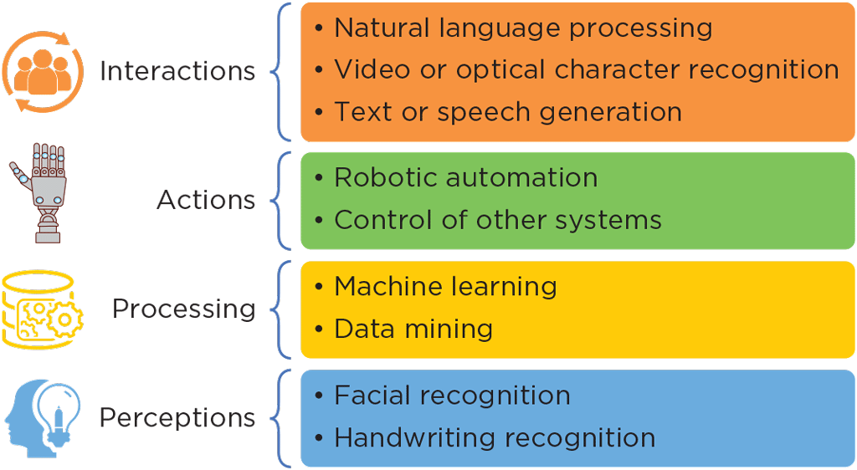
Compare Common AI Learning Models (1 of 3)
Figure 12-14: Many technologies might contribute to a functioning AI system
Campbell/Ciampa/Clemens/Freund/Frydenberg/Hooper/Ruffolo/West, Technology for Success: Computer Concepts, 1st Edition. © 2020 Cengage. All Rights Reserved. May not be scanned, copied or duplicated, or posted to a publicly accessible website, in whole or in part.

Slide 20
Compare Common AI Learning Models (2 of 3)
An AI system needs incoming information, called a dataset, to learn from
Might use one of these learning models to guide how it engages with datasets:
Supervised learning
Unsupervised learning
Reinforcement learning
Campbell/Ciampa/Clemens/Freund/Frydenberg/Hooper/Ruffolo/West, Technology for Success: Computer Concepts, 1st Edition. © 2020 Cengage. All Rights Reserved. May not be scanned, copied or duplicated, or posted to a publicly accessible website, in whole or in part.

Slide 21
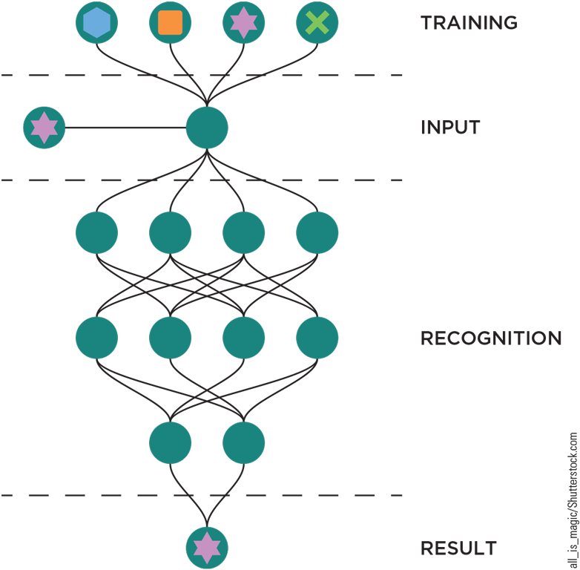
Compare Common AI Learning Models (3 of 3)
Figure 12-16: Deep learning allows for pattern recognition
Campbell/Ciampa/Clemens/Freund/Frydenberg/Hooper/Ruffolo/West, Technology for Success: Computer Concepts, 1st Edition. © 2020 Cengage. All Rights Reserved. May not be scanned, copied or duplicated, or posted to a publicly accessible website, in whole or in part.

Slide 22
Use AI Technologies (1 of 2)
Describe how AI supports smart devices and the Internet of Things
Identify ways people use AI in the workplace
Campbell/Ciampa/Clemens/Freund/Frydenberg/Hooper/Ruffolo/West, Technology for Success: Computer Concepts, 1st Edition. © 2020 Cengage. All Rights Reserved. May not be scanned, copied or duplicated, or posted to a publicly accessible website, in whole or in part.

Slide 23
Use AI Technologies (2 of 2)
AI is an integral part of our daily technological lives
Many processes happen in the background and don’t require special knowledge on the part of the user
It’s helpful to have a basic understanding of AI and its underlying technologies
Campbell/Ciampa/Clemens/Freund/Frydenberg/Hooper/Ruffolo/West, Technology for Success: Computer Concepts, 1st Edition. © 2020 Cengage. All Rights Reserved. May not be scanned, copied or duplicated, or posted to a publicly accessible website, in whole or in part.

Slide 24
Describe How AI Supports Smart Devices and the Internet of Things
Smart devices are considered “smart” because they can be programmed to make decisions without direct human intervention
To work properly, they typically must be connected to the Internet through a Wi-Fi or Bluetooth connection
Collectively, the devices (which all contain embedded processors) are referred to as the Internet of Things (IoT)
AI’s role in a smart home environment revolves around the user’s interaction with voice commands as well as processing data collected from IoT devices
Personal devices such as a smart watch or a medical sensor might incorporate AI capabilities for data processing or human interactions
IoT has also permeated the manufacturing, medical, and financial industries, as well as many others
Campbell/Ciampa/Clemens/Freund/Frydenberg/Hooper/Ruffolo/West, Technology for Success: Computer Concepts, 1st Edition. © 2020 Cengage. All Rights Reserved. May not be scanned, copied or duplicated, or posted to a publicly accessible website, in whole or in part.

Slide 25
Identify Ways People Use AI in the Workplace
Forms of AI you might need to interact with on the job:
Data analytics: manage data and detect patterns that improve business processes and answer questions related to strategic planning
Robotic process automation (RPA): automatic processes running on servers that input or transfer data
AI-powered chatbots: serve a variety of purposes, such as FAQ bots to answer common questions about typical business, conversational bots that can provide problem-solving support and assist in finding a product or service, and transactional bots that assist with making purchases and payments or returning items
Campbell/Ciampa/Clemens/Freund/Frydenberg/Hooper/Ruffolo/West, Technology for Success: Computer Concepts, 1st Edition. © 2020 Cengage. All Rights Reserved. May not be scanned, copied or duplicated, or posted to a publicly accessible website, in whole or in part.

Slide 26
Analyze Ways to Communicate More Proficiently with AI Systems (1 of 2)
Phrase effective AI commands
Campbell/Ciampa/Clemens/Freund/Frydenberg/Hooper/Ruffolo/West, Technology for Success: Computer Concepts, 1st Edition. © 2020 Cengage. All Rights Reserved. May not be scanned, copied or duplicated, or posted to a publicly accessible website, in whole or in part.

Slide 27
Analyze Ways to Communicate More Proficiently with AI Systems (2 of 2)
A significant goal of AI developers is to advance AI technology sufficiently so that human users can’t tell the difference between a machine and a human on the other end of a conversation
A sufficiently advanced AI system could sound just as natural and be just as responsive as a human technician
This challenge, which AI has not yet fully met, is called the Turing Test
Some systems have managed to trick users in specific situations
Tend to be very limited in scope
Campbell/Ciampa/Clemens/Freund/Frydenberg/Hooper/Ruffolo/West, Technology for Success: Computer Concepts, 1st Edition. © 2020 Cengage. All Rights Reserved. May not be scanned, copied or duplicated, or posted to a publicly accessible website, in whole or in part.

Slide 28
Phrase Effective AI Commands (1 of 2)
Smartphone apps and smart speakers listen for a wake word that alerts the app to record and interpret whatever is said
If you want Alexa to give you the day’s weather forecast, you might say, “Alexa, what’s the weather for today?”
Alexa detects the wake word “Alexa,” and then records and interprets whatever comes next
Developers must consider the many possible variations in the ways different people might ask for a weather update
“Alexa, get me the weather forecast.”
“Alexa, what’s the weather like?”
“Alexa, how cold will it be today?”
Campbell/Ciampa/Clemens/Freund/Frydenberg/Hooper/Ruffolo/West, Technology for Success: Computer Concepts, 1st Edition. © 2020 Cengage. All Rights Reserved. May not be scanned, copied or duplicated, or posted to a publicly accessible website, in whole or in part.

Slide 29
Phrase Effective AI Commands (2 of 2)
Cloud, e-commerce, and artificial intelligence technologies are designed to make technology more accessible, support a global economy, and help streamline repetitive or predictable tasks
These technologies are already used extensively in diverse and creative ways, and will continue to increase in their ability to anticipate user needs
By understanding some basics of how these systems work, you can better take advantage of the benefits they offer
Campbell/Ciampa/Clemens/Freund/Frydenberg/Hooper/Ruffolo/West, Technology for Success: Computer Concepts, 1st Edition. © 2020 Cengage. All Rights Reserved. May not be scanned, copied or duplicated, or posted to a publicly accessible website, in whole or in part.

